Slide 1
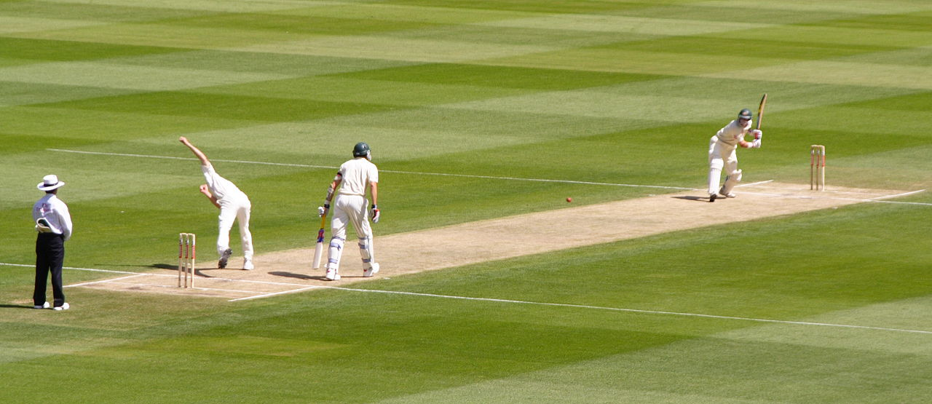
What’s Cricket?
Cricket is a bat-and-ball game played between two teams of 11 players each on a field at the center of which is a rectangular 22-yard long pitch. Each team takes its turn to bat, attempting to score runs, while the other team fields. Each turn is known as an innings.

Slide 2
SOME TYPES OF CRICKET MATCHES
Test Match:
Test cricket is the longest form of the sport of cricket. The two teams of 11 players play a four-innings match, which often lasts up to five days. It is generally considered the most complete examination of teams playing ability and endurance.
ODI:
A One Day International (ODI) is a form of limited overs cricket, played between two teams in which each team faces a fixed number of overs, usually fifty. The Cricket World Cup is played in this format.
T20:
A typical Twenty20 game is completed in about three hours, with each innings lasting around 75–90 minutes and a 10–20-minute interval. This is much shorter than previously-existing forms of the game, and is closer to the timespan of other popular team sports. It was introduced to create a fast-paced form of the game which would be attractive to spectators at the ground and viewers on television.

Slide 3
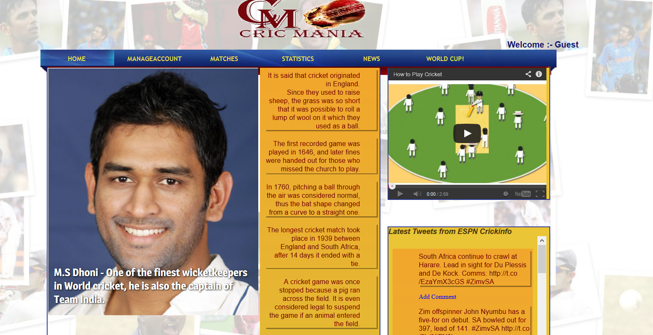
Home Page

Slide 4


TWEETS
Tweets retrieved from twitter API.
Tweets are rendered in the home page towards the bottom right of the screen.
Users can read latest cricket related tweets.
Users can also comment on the tweets by clicking on “Add Comment”. But to comment the user must be a registered user.

Slide 5
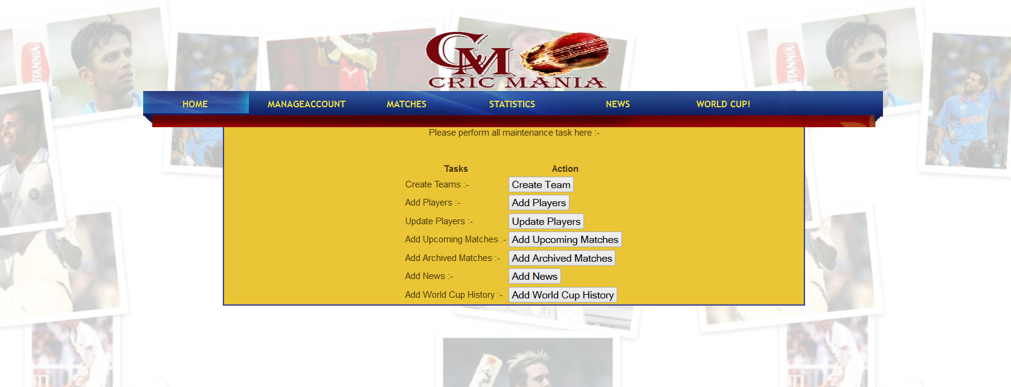
Admin Page

Slide 6



Sign Up & Login
Threat-free sign up and login!!
Our website provides secure sign up and log in. Password is protected using SHA-256(not broken till date). The hashed password is then stored in the database.

Slide 7
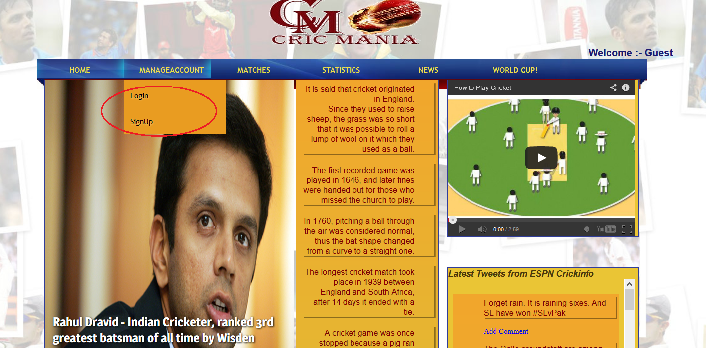

Slide 8
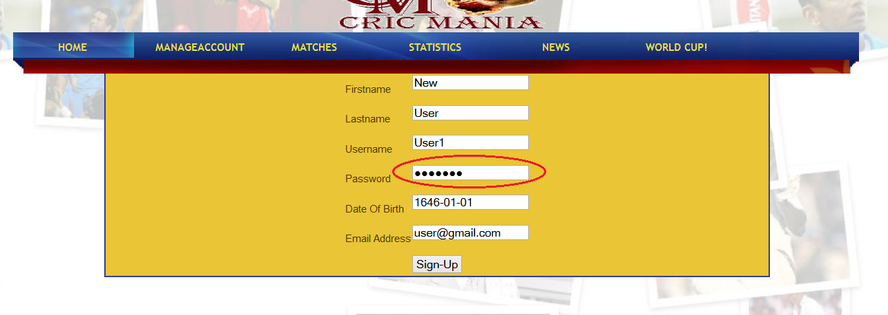

Sign Up & Login

Slide 9
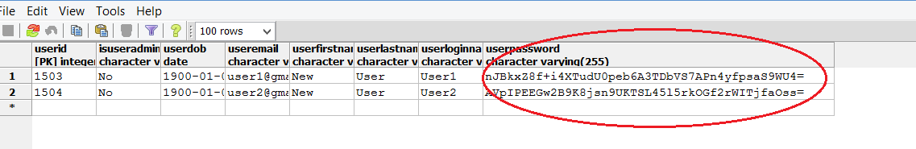
Sign Up & Login

Slide 10
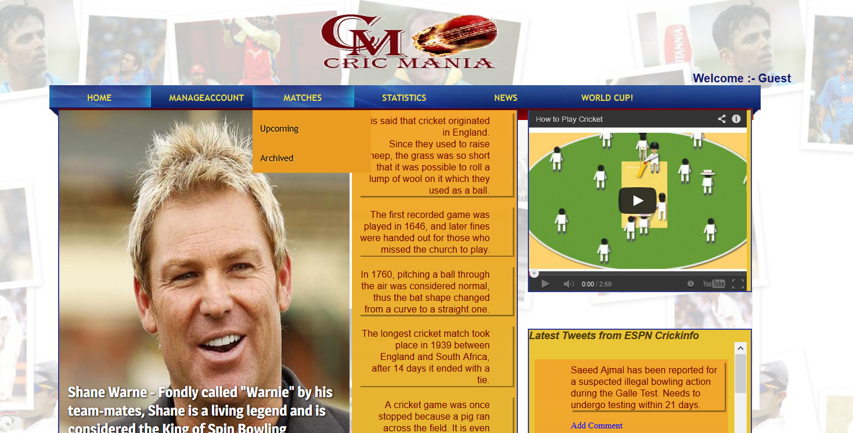
MATCHES
Data about the matches is retrieved from Yahoo’s Rest API and Cricbuzz API.
User not only can see information about archived matches but can get information regarding upcoming matches too!!

Slide 11
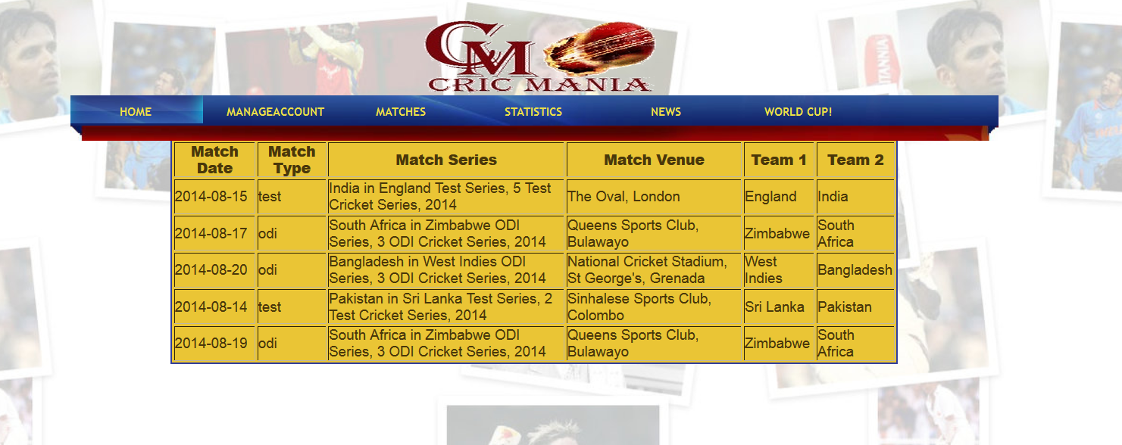

UPCOMING MATCHES

Slide 12
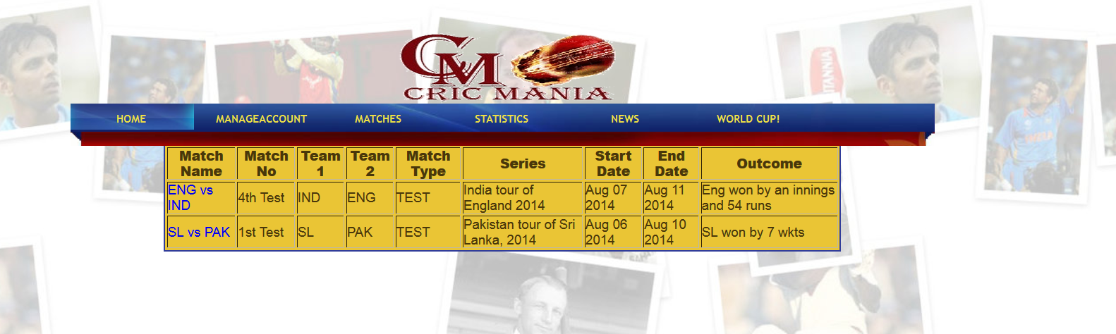
ARCHIVED MATCHES
Additional details about the matches can be obtained by clicking the match name.

Slide 13
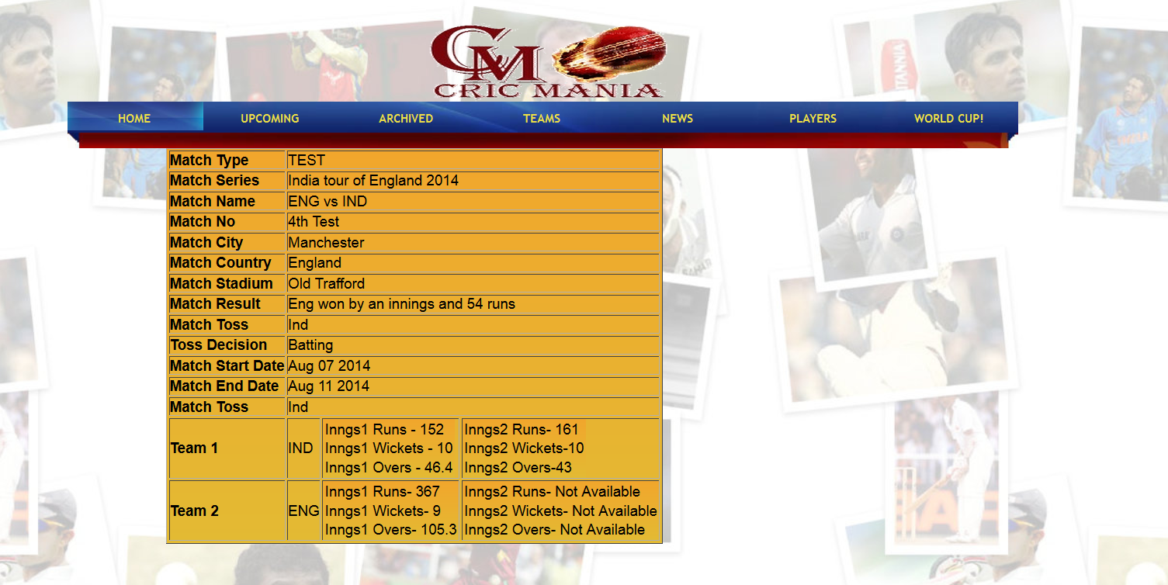
Page rendering detailed information about an archived match.

Slide 14
STATISTICS-TEAMS
Data is rendered from Yahoo’s Rest API.
User is provided with the 10 international teams recognized by ICC and also rankings of teams based on the category, i.e.
Test ranking of teams.
ODI ranking of teams.
T20 ranking of teams.
Users are also given the benefit of viewing more detailed information about the 10 official teams by just clicking on them which leads to redirection to Wikipedia.

Slide 15
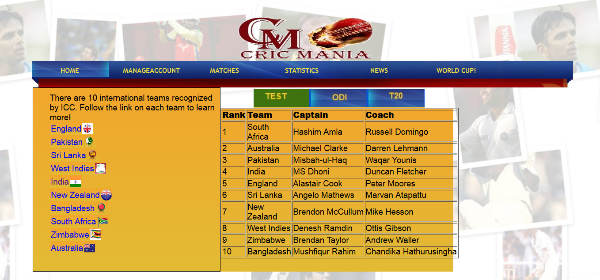

Slide 16
STATISTICS-PLAYERS
Users have the choice of viewing team vise list of active players profile based on the type of game, i.e. either test, ODI or T20.
User can also view a particular players profile by typing in his name in the text box. This helps the user to view profile’s of not only active players but also profile’s of the players who have retired.

Slide 17
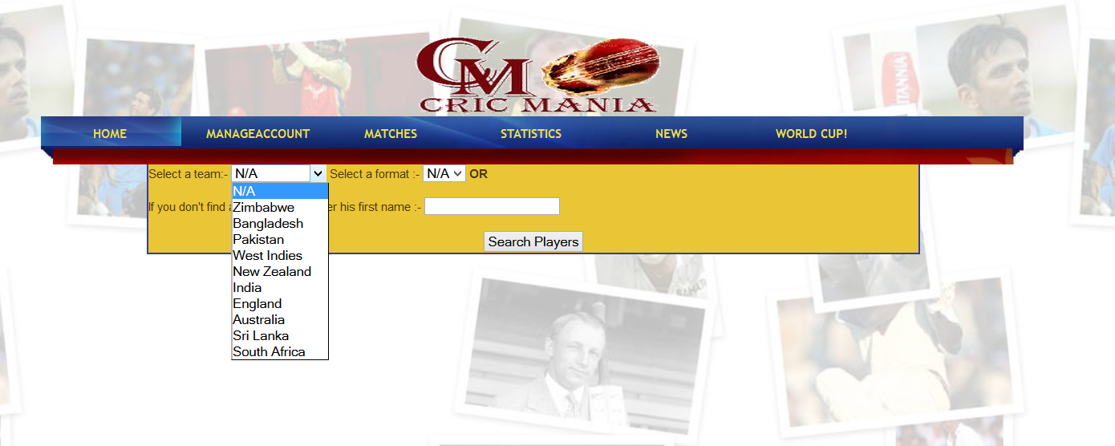
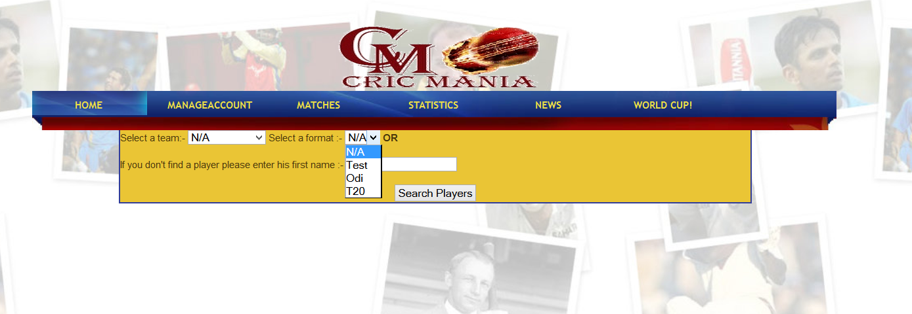

Slide 18
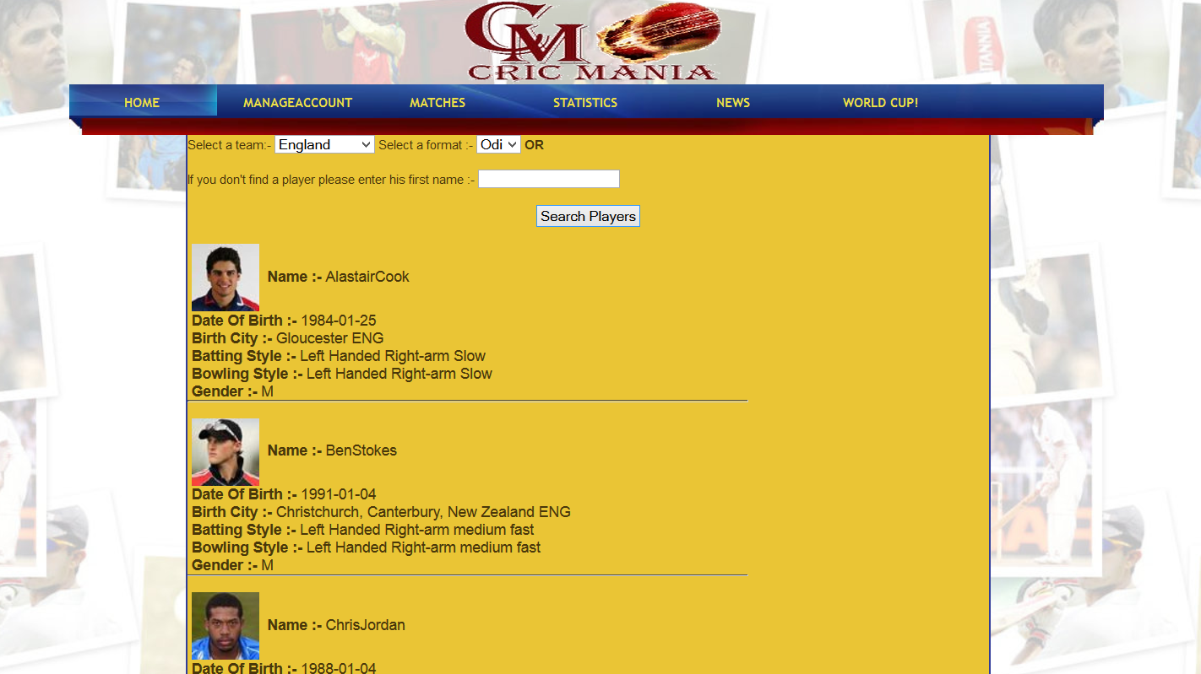

Slide 19
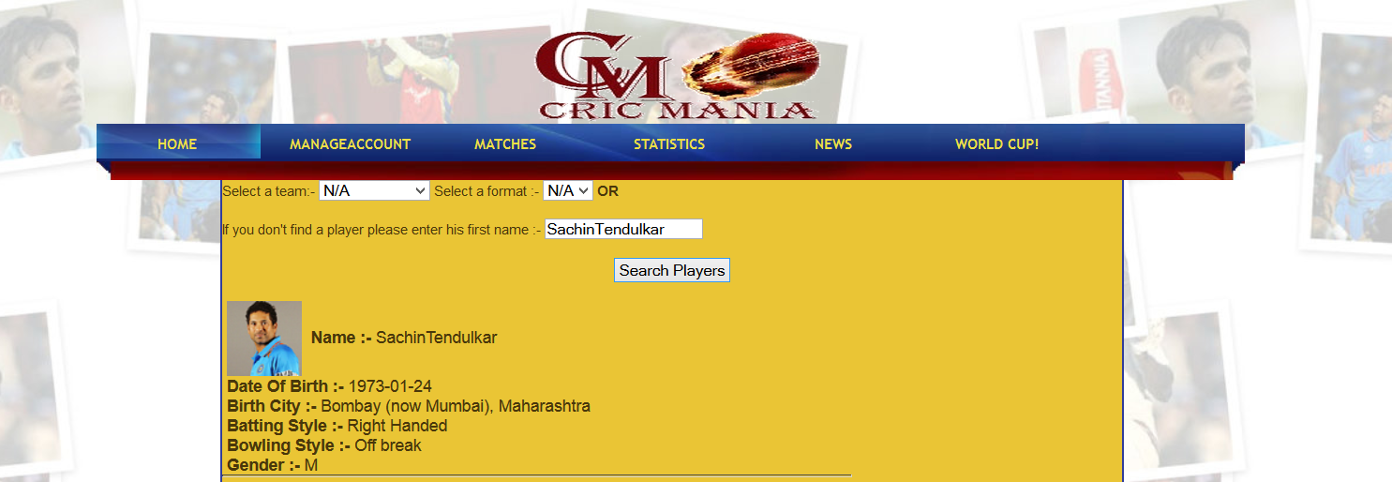

Slide 20
NEWS
News is retrieved from Yahoo’s rest API.
Admin loads the database with the current day’s news.
If user wishes to obtain past news he/she can do so by entering the date in the specified format.
User can also see the detailed news by clicking “Get Detailed news”.
User can also comment on the news by clicking “Add Comment”. But to add a comment user has to either sign up or login, i.e. only registered users can add comments.
Comments entered by the user are stored in our database.

Slide 21
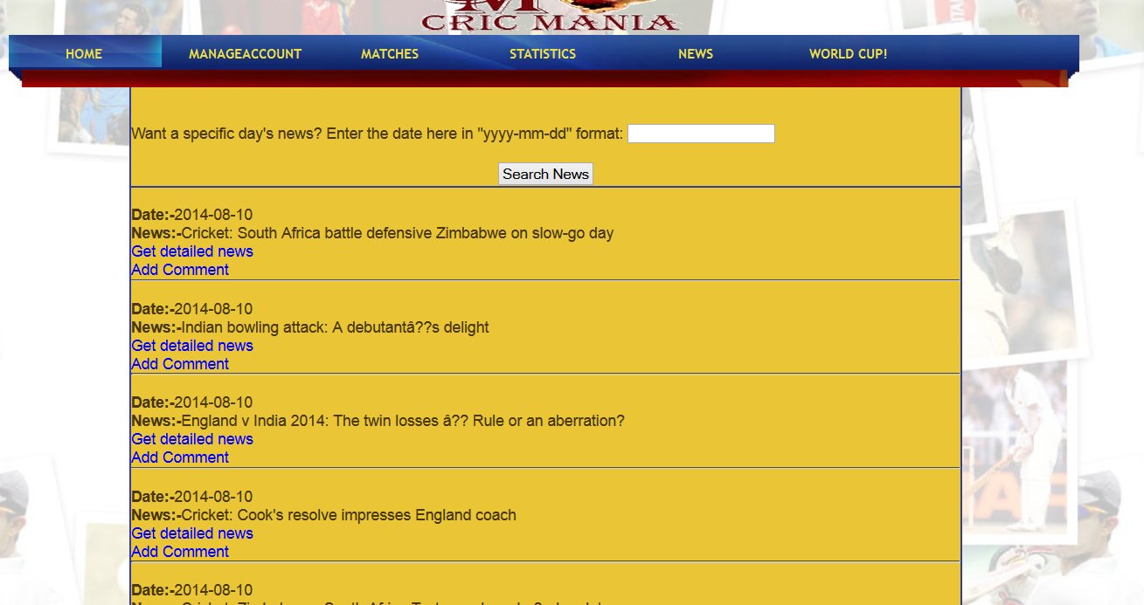

Slide 22
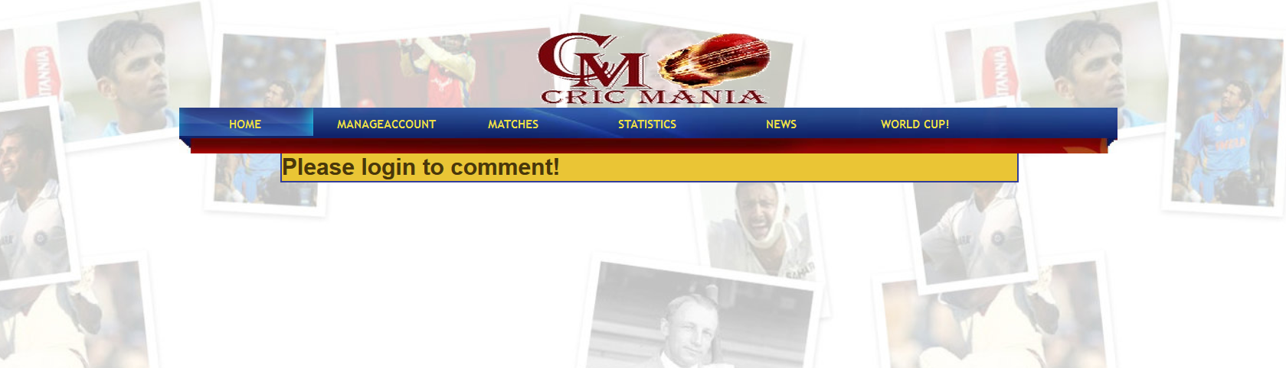
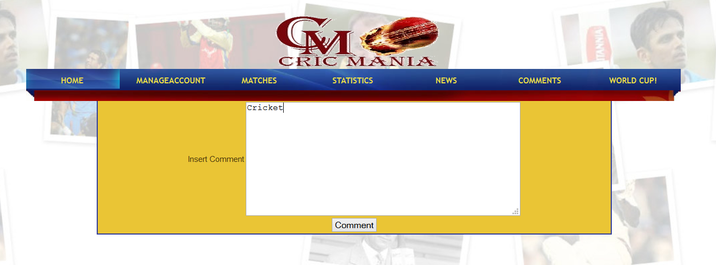

Slide 23
World Cup
This page provides details about all the world cup’s that were held in the past right from the first world cup that was held in 1975 till the last world cup that was held in 2011.
The data for this is retrieved by parsing a “.csv” file and is stored in the database.

Slide 24
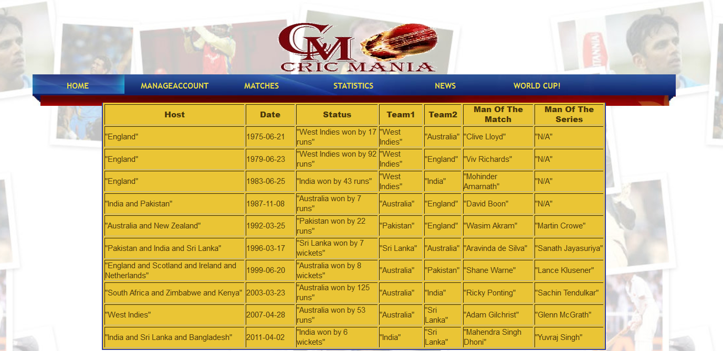

Slide 25
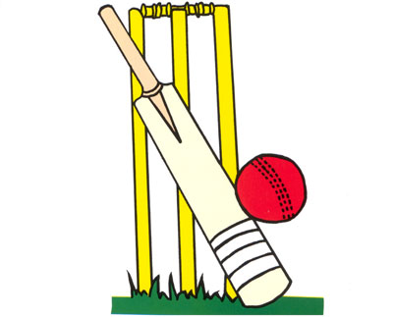
THANK YOU

